Slide 1
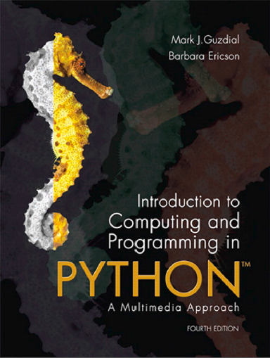
Introduction to Computing and Programming in Python™: A Multimedia Approach
Fourth Edition
Chapter 14
Creating and Modifying Movies
Slides in this presentation contain hyperlinks. JAWS users should be able to get a list of links by using INSERT+F7
Copyright © 2016, 2013, 2010 Pearson Education, Inc. All Rights Reserved
Notes:
If this PowerPoint presentation contains mathematical equations, you may need to check that your computer has the following installed:
1) MathType Plugin
2) Math Player (free versions available)
3) NVDA Reader (free versions available)
Thanks to John Sanders of Suffolk University for contributions to these slides!

Slide 2
Learning Objectives
14.1 To understand how a series of still images can be perceived as motion.
14.2 To create animations with different motions and effects.
14.3 To use video sources for animations and processing.
14.4 To work out how a digital effect is implemented.
14.5 To understand another example of using multiple functions to make coding easier.
14.6 To understand a detailed example of bottom-up design and implementation.
14.7 To use optional and named arguments to Python functions.

Slide 3
Movies, Animations, and Video …Oh My!
We’re going to refer generically to captured (recorded) motion as “movies.”
This includes motion entirely generated by graphical drawings, which are normally called animations.
This also includes motion generated by some kind of photographic process, normally called video.

Slide 4
Psychophysics of Movies: Persistence of Vision
What makes movies work is yet another limitation of our visual system: Persistence of vision
We do not see every change that happens in the world around us.
Instead, our eye retains an image (i.e., tells the brain “This is the latest! Yup, this is still the latest!”) for a brief period of time.
If this were not the case, you would be aware of every time that your eye blinks because the world would “go away” for a moment.

Slide 5
16 Frames and It’s Motion
If you see 16 separate pictures in one second, and these pictures are logically sequenced,
That is, #2 could logically follow from the scene in #1.
16 pictures of completely different things doesn’t work,
You will perceive the pictures as being in motion.
16 frames per second (f p s), 16 pictures in a second, is the lower bound for the sensation of motion.

Slide 6
Beyond 16 Framespersecond
Early silent pictures were 16 framespersecond.
Motion picture standards shifted to 24 framespersecond to make sound smoother.
Videocameras (digital video) captures 30 framespersecond
How high can we go?
Air force experiments suggest that pilots can recognize a blurb of light in 1/200th of a second!
Video game players say that they can discern a difference between 30 framespersecond and 60 framespersecond.
Bottomlines:
Generate at least 16 framespersecond and you provide a sense of motion.
If you want to process video, you’re going to have 30 framespersecond to process (unless it’s been modified elsewhere for you.)

Slide 7
Processing Movies
Our frames are going to be J P E G pictures.
One J P E G file per frame.
So, if we’re going to be processing movies, we’re going to generating or processing sequences of J P E G files.
Three tools for manipulating movies
MediaTools
QuickTime Pro (free QuickTime won’t do it)
Windows Movie Maker (for converting image sequences to movies)

Slide 8
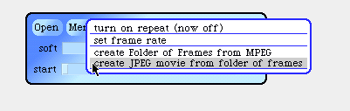
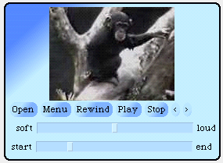
Using Mediatools
To generate a series of frame pictures in a folder from an M P E G file.
To play a folder of frame pictures and to save it as a J M V file.
(J P E G Movie format.)
To play J M V or M P E G movies.

Slide 9
What the Other Tools Can Do
QuickTime Pro (http://www.apple.com/quicktime) can read a sequence of J P E G images and produce M P E G, A V I, or QuickTime movies.
Windows Movie Maker can create W M V (Windows Media Player movies) from image sequences.
ImageMagick (open source toolkit) can also read a sequence of J P E G images and produce M P E G movies.

Slide 10
M P E G? Quicktime? A V I? J M V?
M P E G, QuickTime, and A V I are compressed movie formats.
They don’t record every frame.
Rather, they record some key frames, and then store data about what parts of the screen change on intervening frames.
M P E G is an international standard, from the same people who invented J P E G.
A V I is a Microsoft standard.
QuickTime is an Apple standard.
J M V is a file consisting of J P E G frames in an array.
All frames represented

Slide 11
Why Do We Compress Movies?
Do the math:
One second of 640×480 pixels at 30 framespersecond
With 3 bytes of color per pixel, that’s 27,648,000 bytes or 27 megabytes of information per second.
For a 90 minute feature movie (short), that’s
A D V D stores 6.47 gigabytes of data.
So even on a D V D, the movie is compressed.

Slide 12
M P E G Movie = M P E G Frames plus M P3 Soundtrack
An M P E G movie is actually a series of M P E G frames composed with an M P3 soundtrack.
It’s literally two files stuck together in one.
We’re not going to deal with sound movies for now.
The real challenge in doing movie processing is generating and manipulating frames.

Slide 13
Get the Frames in Order
Many tools
can process frames in
order if the order is specified.
We specify the order by encoding the number of the frame into the name.
If you put in leading zeroes so that everything is the same length, the order is alphabetical as well as numerical.

Slide 14
Movies in J E S
makeMovieFromInitialFile(firstFile) will create a movie object from the image sequence starting from that file.
playMovie(movie) opens a movie player on the movie object. You can write out QuickTime or A V I movies from there.

Slide 15
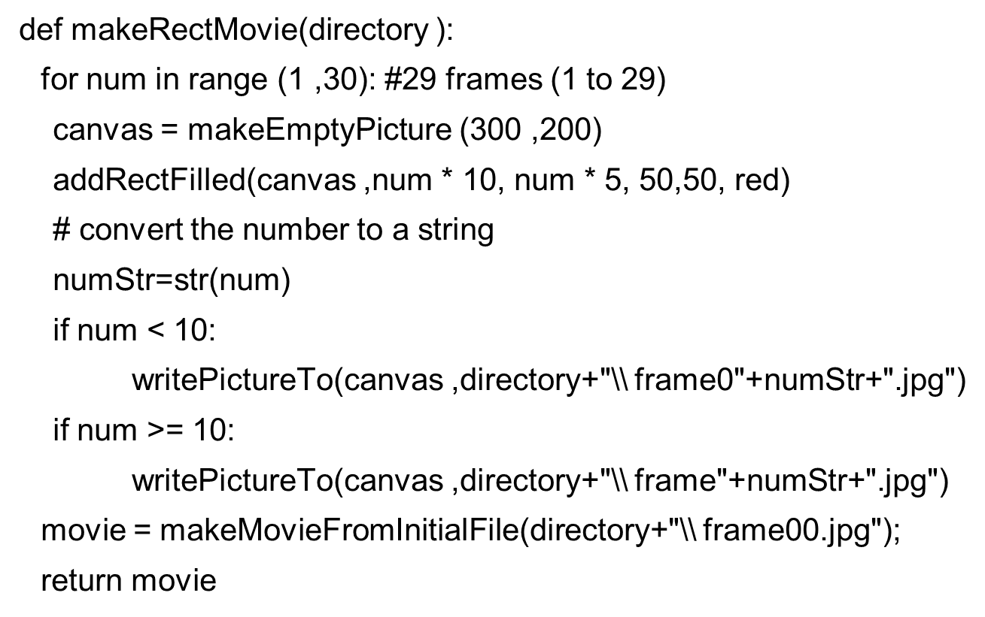
Simple Motion

Slide 16



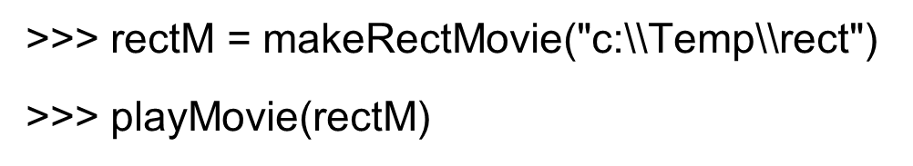
A Few Frames
frame00.jpg
frame02.jpg
frame50.jpg
Notes:
Show the movie here
Show the movie here

Slide 17
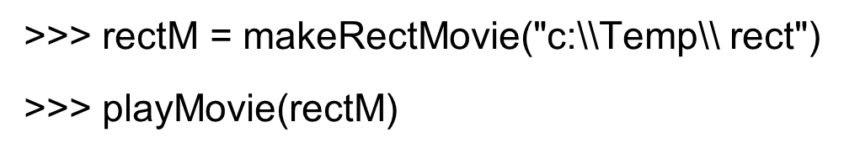
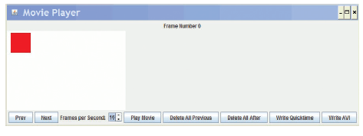
Making and Playing the Movie

Slide 18
Important Cool Thing: You Can Draw Past the End of the Picture!
addText, addRect, and the rest of the drawing tools will work even if you go beyond the edge of the drawing.
Drawings will clip what can’t be seen in them, so you don’t get an array out of bounds error.
This is a big deal, because it means that you don’t have to do complicated math to see when you’re past the end of the drawing.
But only for the drawing functions.
If you set pixels, you’re still on your own to stay in range.

Slide 19
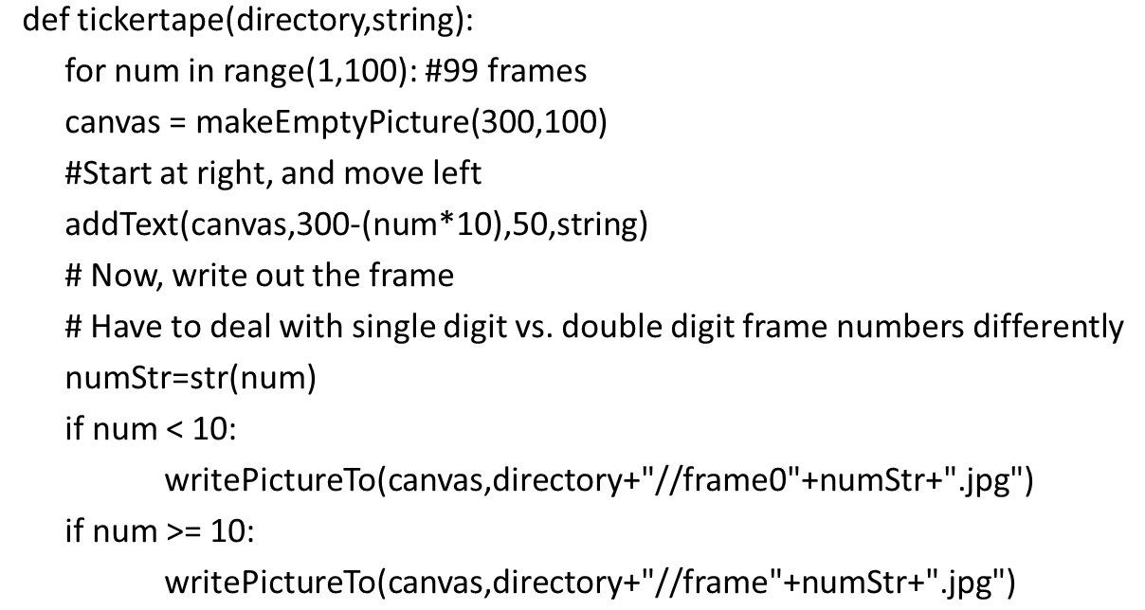
Making a Tickertape

Slide 20
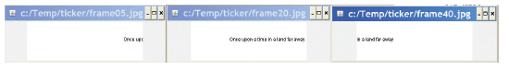
Playing the Tickertape Movie

Slide 21
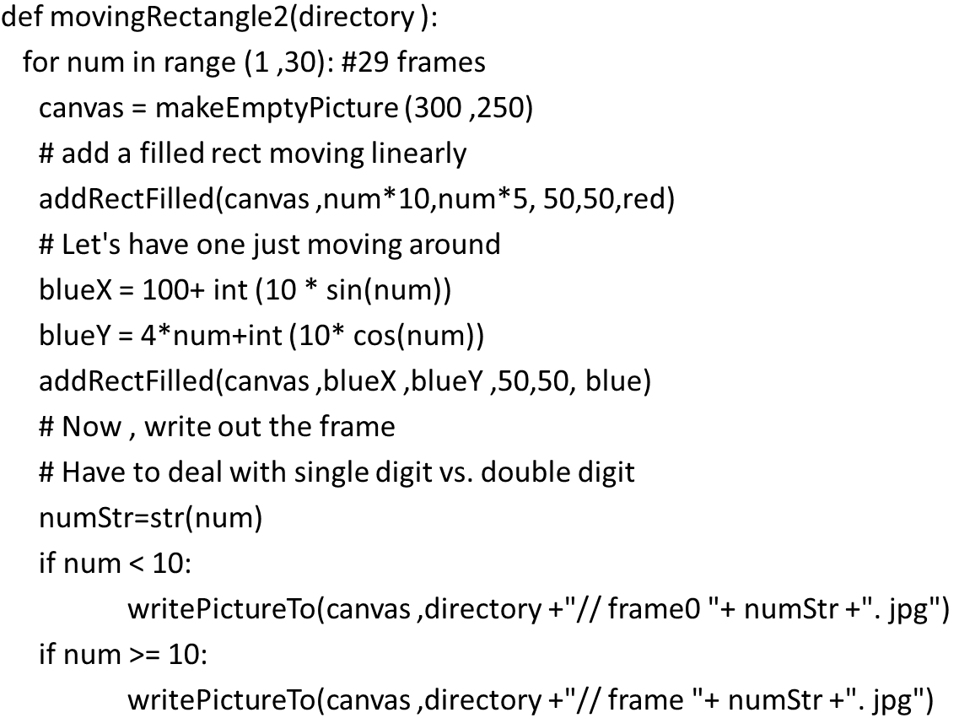
Can We Move More Than One Thing at Once? Sure!

Slide 22
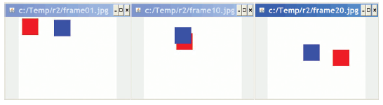
Moving Two Things at Once

Slide 23
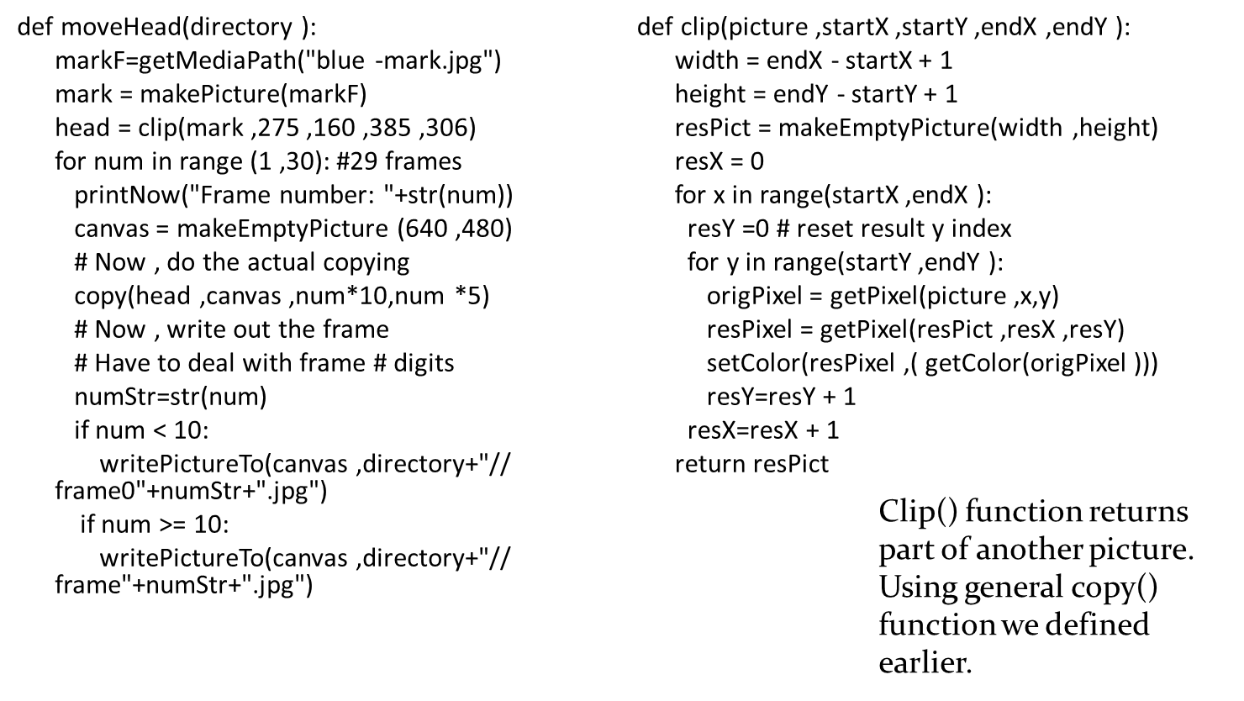
Moving a Clip from a Picture

Slide 24
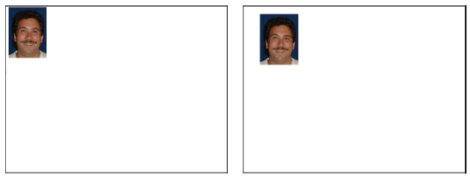
Moving around Mark’s Head

Slide 25
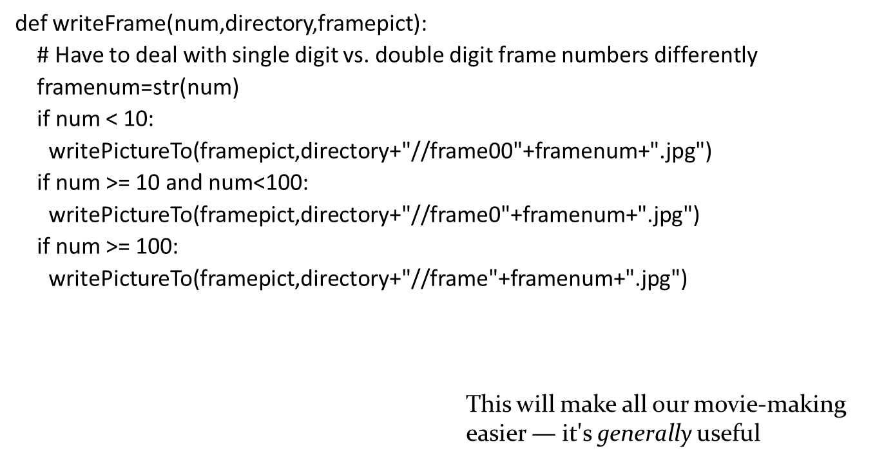
What if We Have over 100 Frames?

Slide 26
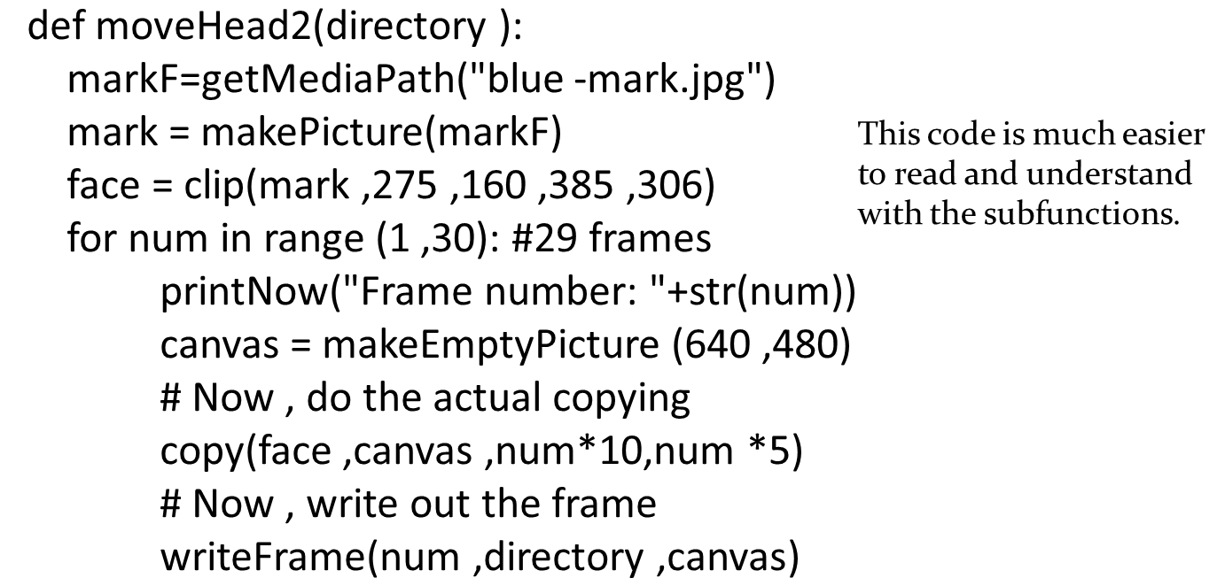
Rewriting Moving Mark’s Head

Slide 27
Using Real Photographs
Of course, we can use any real photographs we want.
We can use any of the techniques we’ve learned previously for manipulating the photographs.
Even more, we can use the techniques in new ways to explore a range of effects.

Slide 28
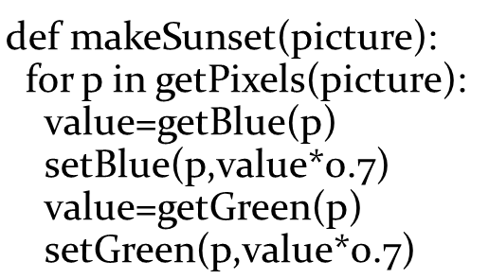
Slowly Making It (Very) Sunset
Remember this code?
What if we applied this to create frames of a movie, but slowly increased the sunset effect?

Slide 29
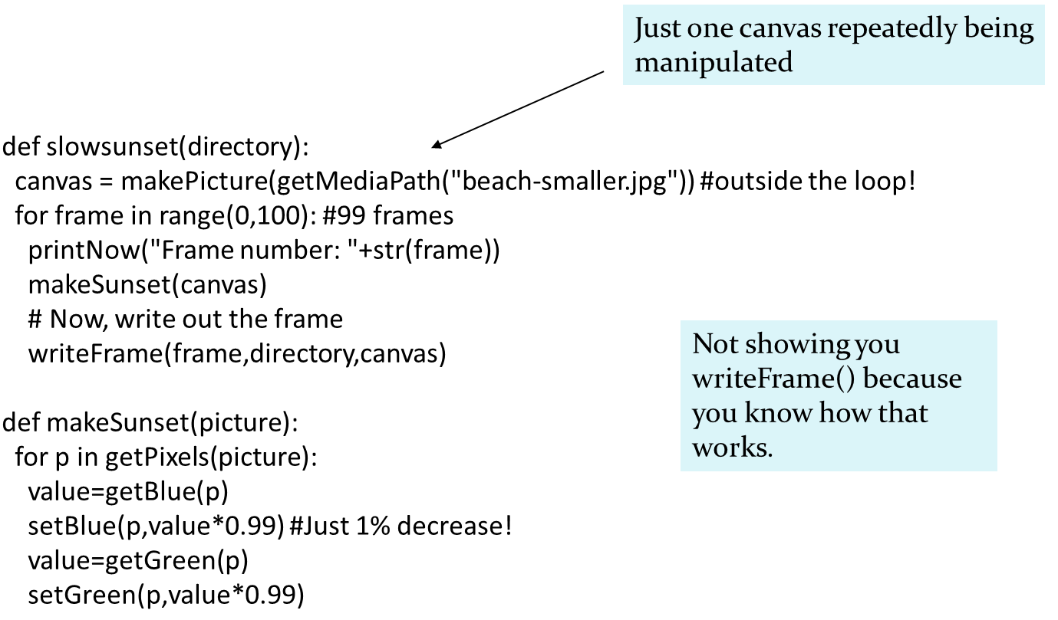
SlowSunset
Notes:
Actually run this one in the background while we go on, to show the amount of time this takes.
Actually run this one in the background while we go on, to show the amount of time this takes.

Slide 30
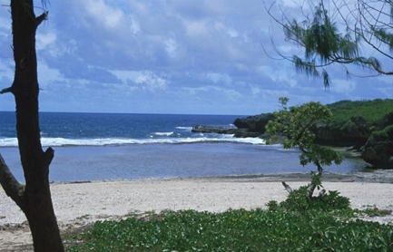
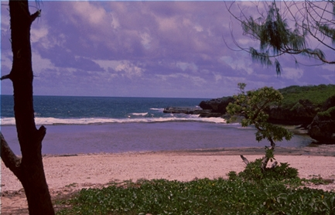
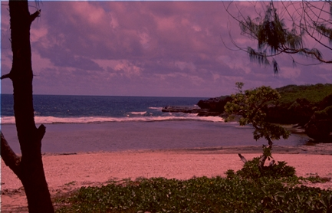
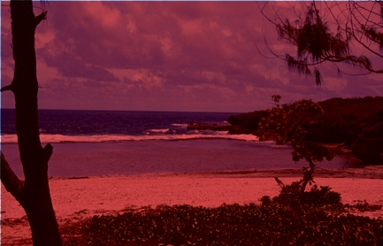
SlowSunset Frames

Slide 31
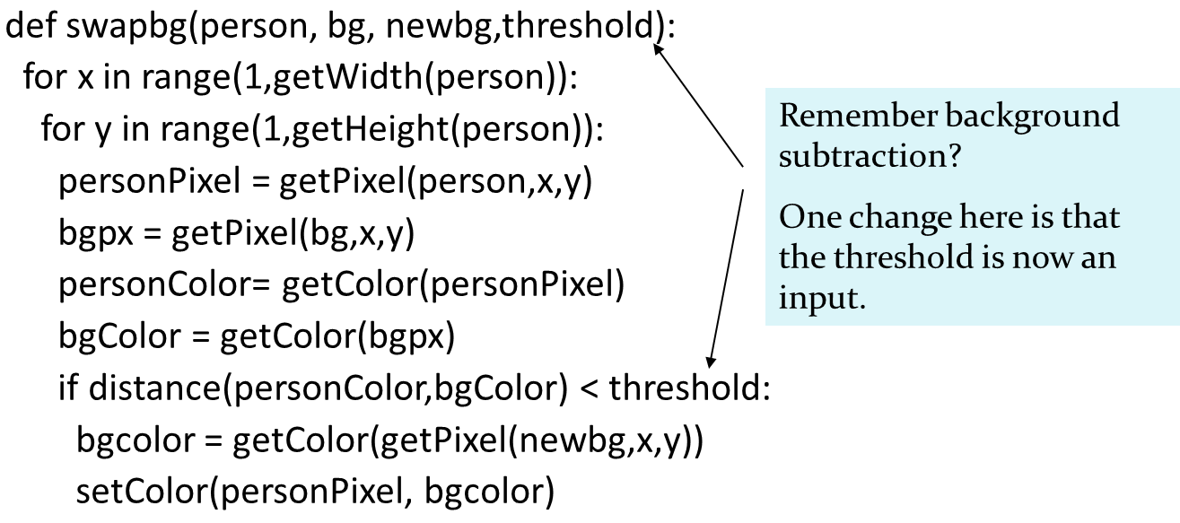
Fading by Background Subtraction

Slide 32
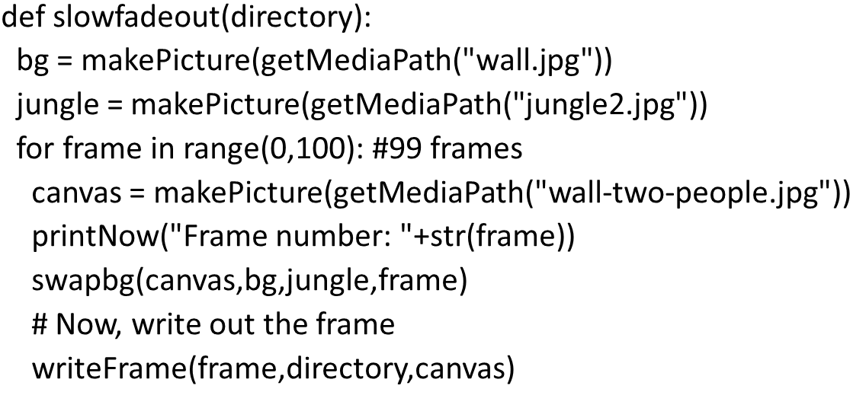
Use the Frame Number as the Threshold

Slide 33
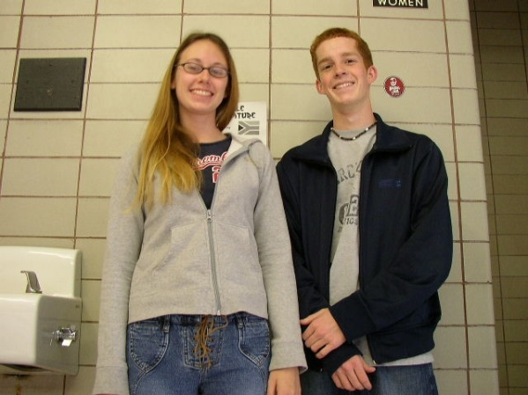
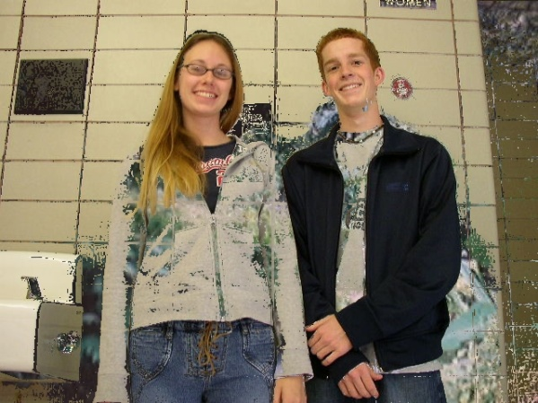
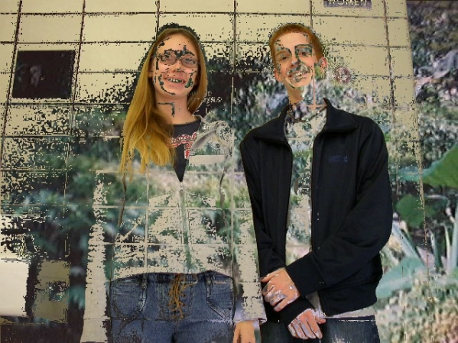
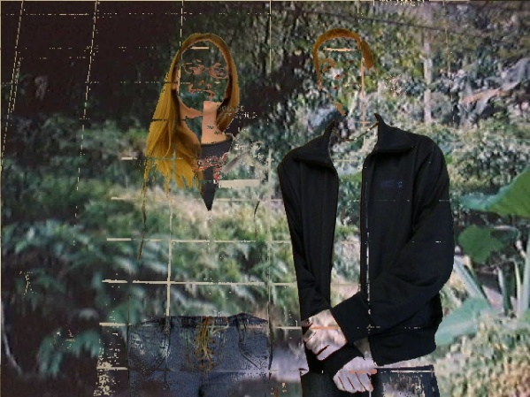
SlowFadeout

Slide 34
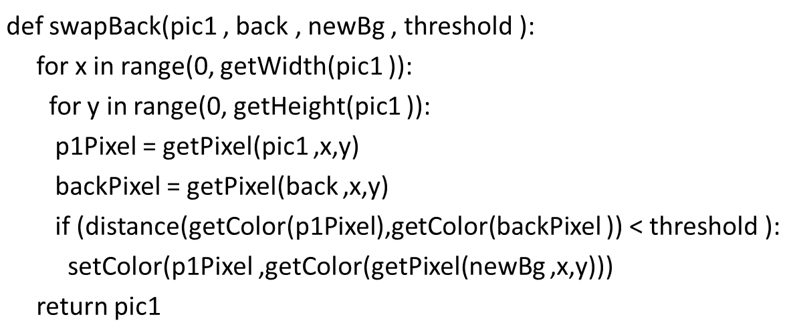
Different Images, with Subfunctions (1 of 2)

Slide 35
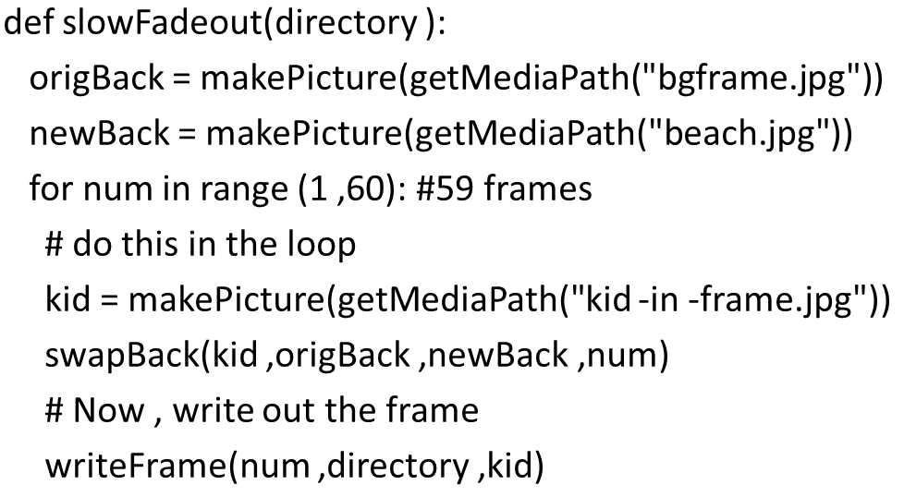
Different Images, with Subfunctions (2 of 2)

Slide 36
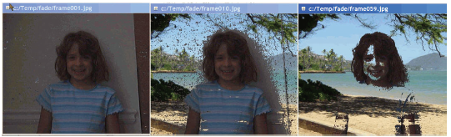
Cool Effect!

Slide 37
Dealing with Real Video
We really can’t deal with live video.
Dealing with each frame takes a lot of processing.
If you were going to process each frame as fast as it was coming in (or going out), you’d have 1/30th of a second to process each frame!
We cheat by
Saving each frame as a J P E G image
Processing the J P E G images
Convert the frames back to a movie

Slide 38
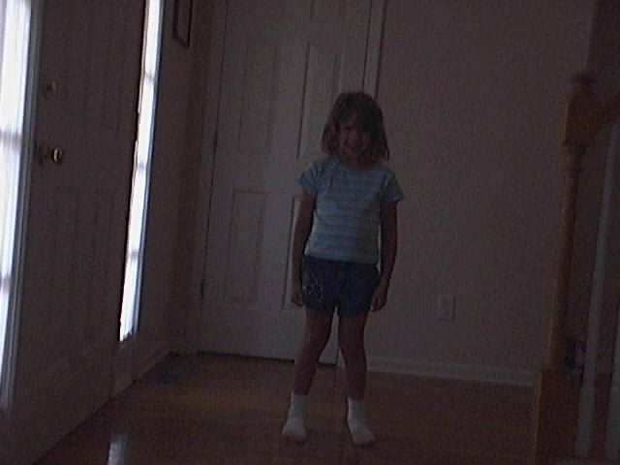
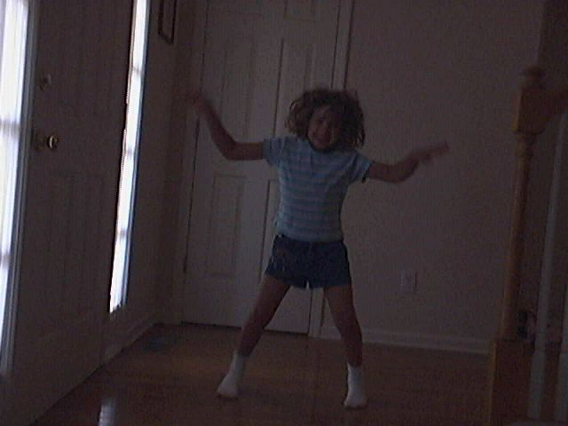
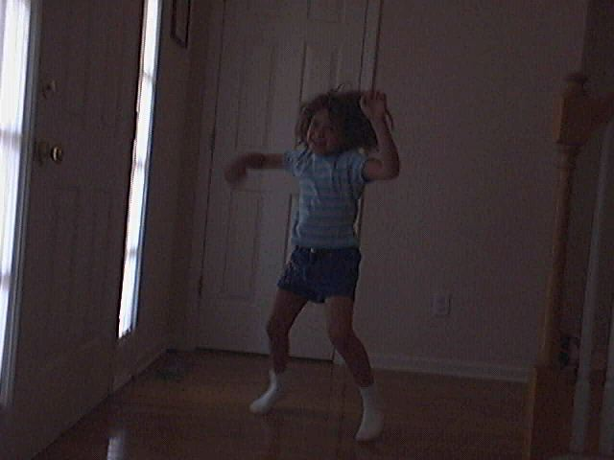
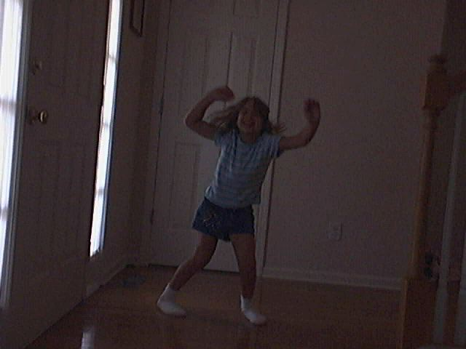
The Original Kid-In-Bg-Seq Movie

Slide 39
Let’s Have Mommy “Watching”
We’ll paste Barb’s head into each frame.
We’ll use os.listdir to process all the frames of the kid sequence.

Slide 40
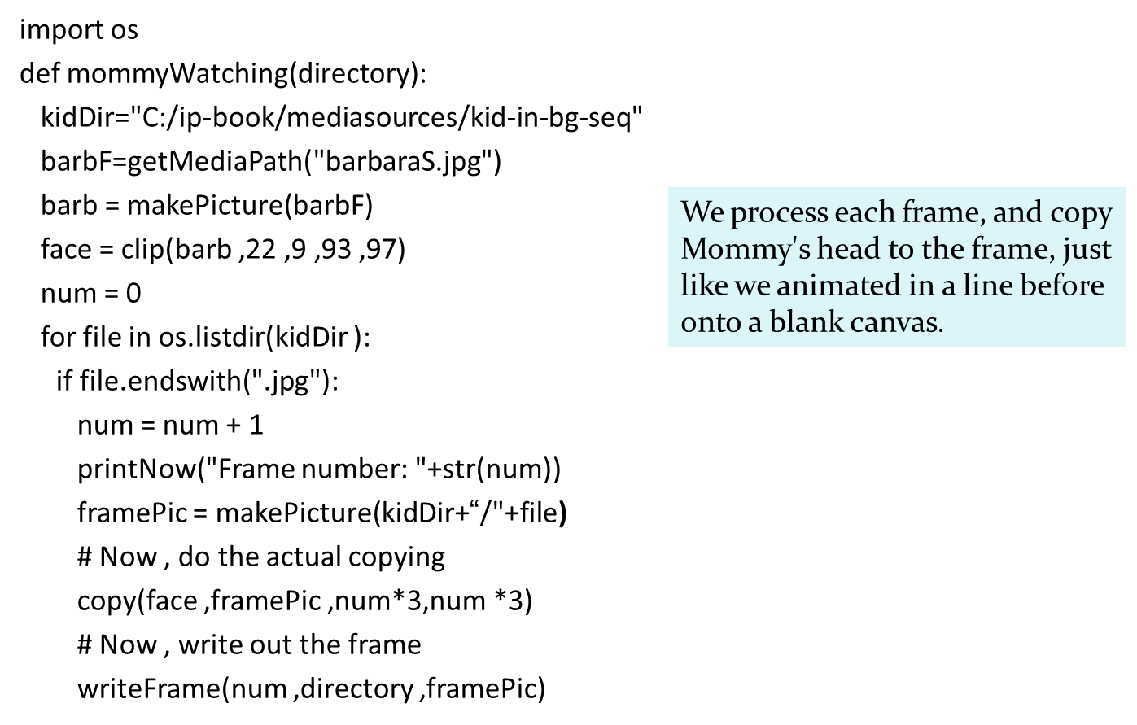
MommyWatching (1 of 2)

Slide 41
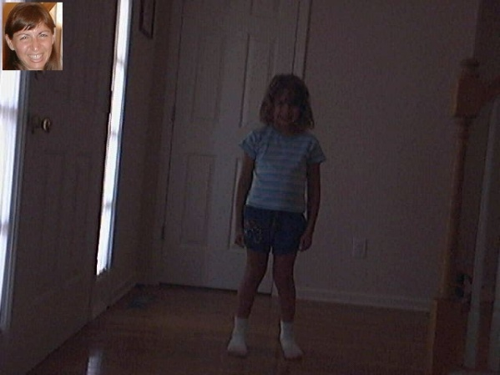
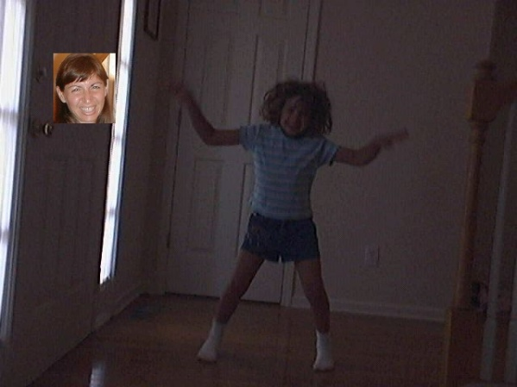
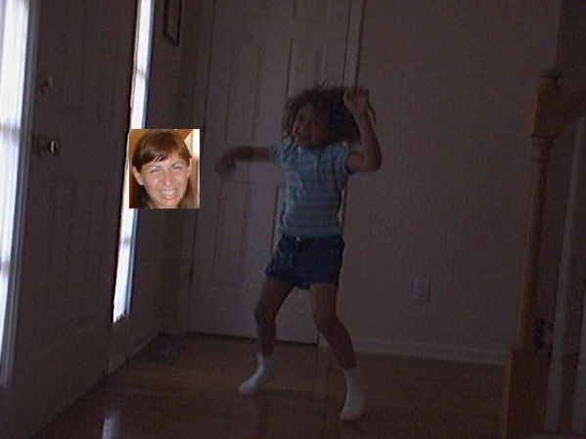
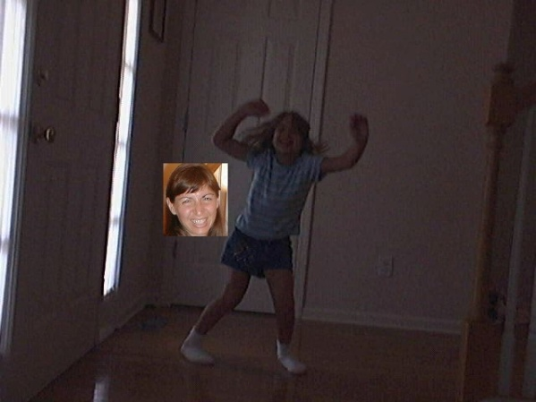
MommyWatching (2 of 2)

Slide 42
Lightening a Picture
I took some video of a puppet show in black light.
Very hard to see the puppets.
Your eye can pick them up, but the camera can’t.
Recall earlier discussion: Your eye can detect luminance changes that no media can replicate.

Slide 43
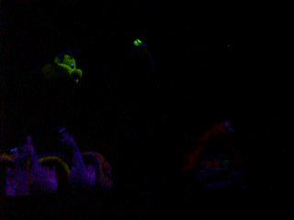
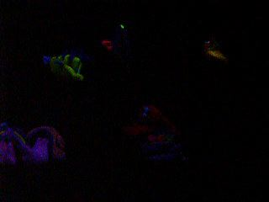
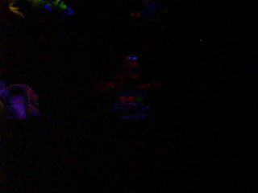
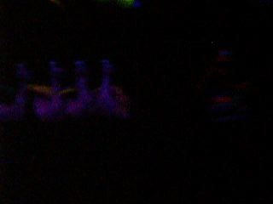
Dark-Fish2 Sequence

Slide 44
How I Did the Processing
First try, lighten every pixel.
Didn’t work.
Made all the black whiter as well as the colors
No improvement in contrast
Second try, explore under MediaTools first
Black parts are really black
Lighter parts have really low number values
So:
Look for any pixel less black than black (threshold=8)
Lighten it a couple values

Slide 45
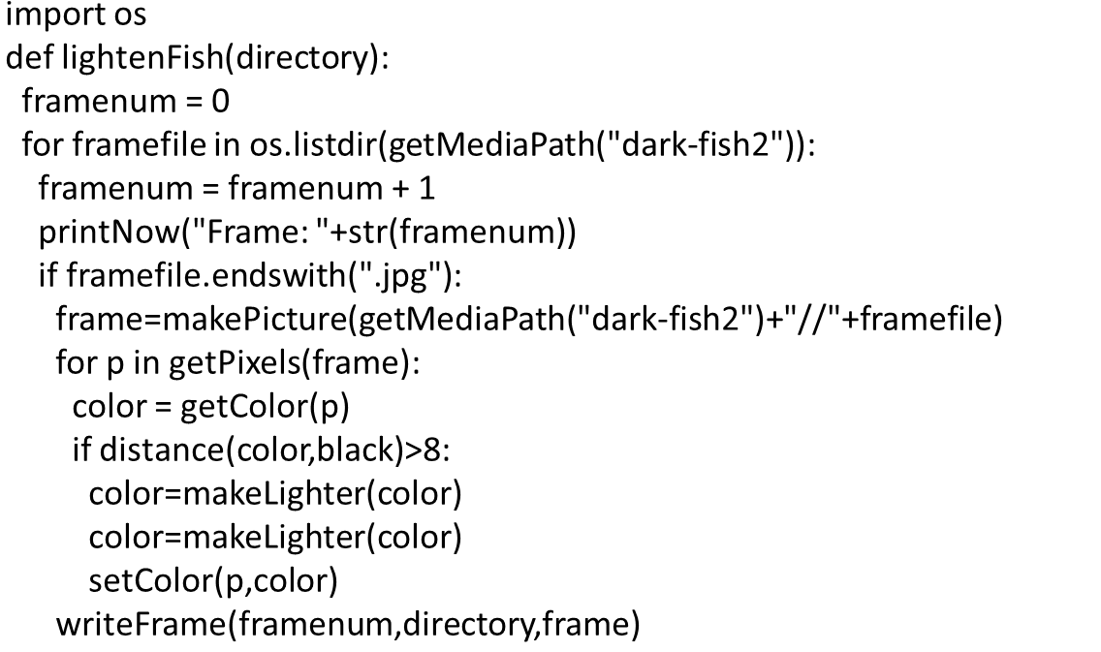
Lightenfish

Slide 46
Original Sequence Again

Slide 47

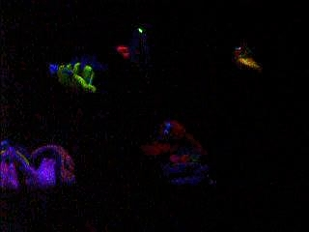
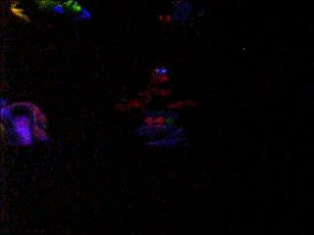
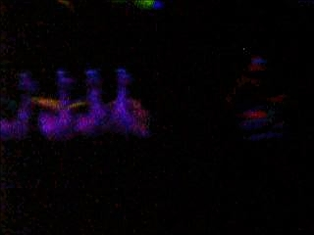
Same Frames after Lightening

Slide 48
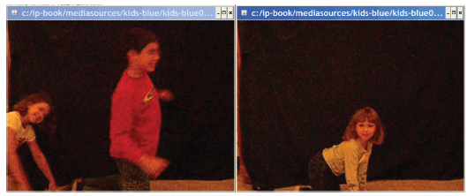
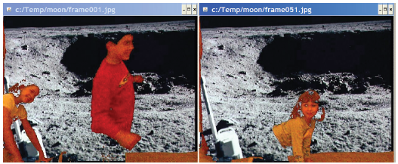
Putting Kids on the Moon
Took a video of our kids crawling past a blue sheet.
Unfortunately, did it in front of electric light, not daylight.
Not really blue.
If you chromakey against black, pants and eyeballs go away.

Slide 49
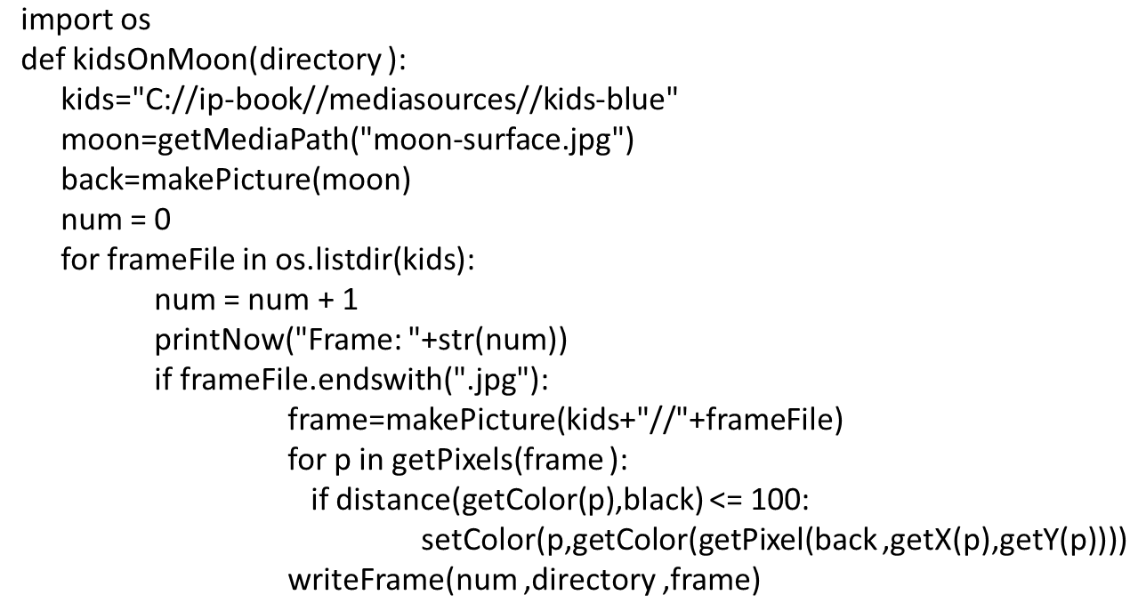
Code for Putting Kids on Moon

Slide 50


Making Underwater Movies Look Better
Water filters out red and yellow light.
We can color-correct underwater footage by increasing red and green.
Before:
After:

Slide 51

Code for Fixing Underwater Footage
Creating a useful function to make the task easier.

Slide 52
Building an Effect from the Bottom Up
Notice that the underwater footage code was made cleaner and clearer through use of an extra, “helper” function.
Made the main function easier to read and shorter to write.
We can build visual effects “bottom-up” by building helper functions first, then assembling them all.

Slide 53

Drawing with Light
Many commercials feature actors “drawing” with light.
Light beams that seem to hang in the air.
How could we do that?

Slide 54
Our Algorithm
The light should create high luminance pixels.
From frame 1, for each pixel of high luminance, copy the color to frame 2.
Now frame 2 contains the high luminance from frame 1 and from frame 2
Go on to frame 2 and 3, and back to step 1.
Each frame now contains the “trace” of light from all the previous frames.

Slide 55

Input
Having my kids draw in darkness (to make sure luminance difference is large) with flashlights and light sticks.

Slide 56

What Do We Need? First Step: Compute Luminance

Slide 57

Test the Pieces
As we build each piece, we test it.
You don’t want to build more on top of it until you know this works!
We make a small picture so that we can a pixel to known colors and check its luminance.

Slide 58


Is That Bright Enough?
Using a Python feature that allows you to specify an optional parameter with a default value. We can specify a threshold, but if we don’t, it will be 100.
This could also be written:

Slide 59


Testing Our Brightness Function

Slide 60

Walking through the List of Files

Slide 61

Testing the File List Functions

Slide 62

Now, Putting it All Together!

Slide 63

Final Frame of a Light-Drawing Movie

Slide 64
Why?
Why does movie processing take so long?
Why does sound processing seem to go so fast?
Why can Photoshop do these things faster than we can in Python?
What makes software fast, or slow?
Coming soon…

Slide 65

Copyright

